Slide 1
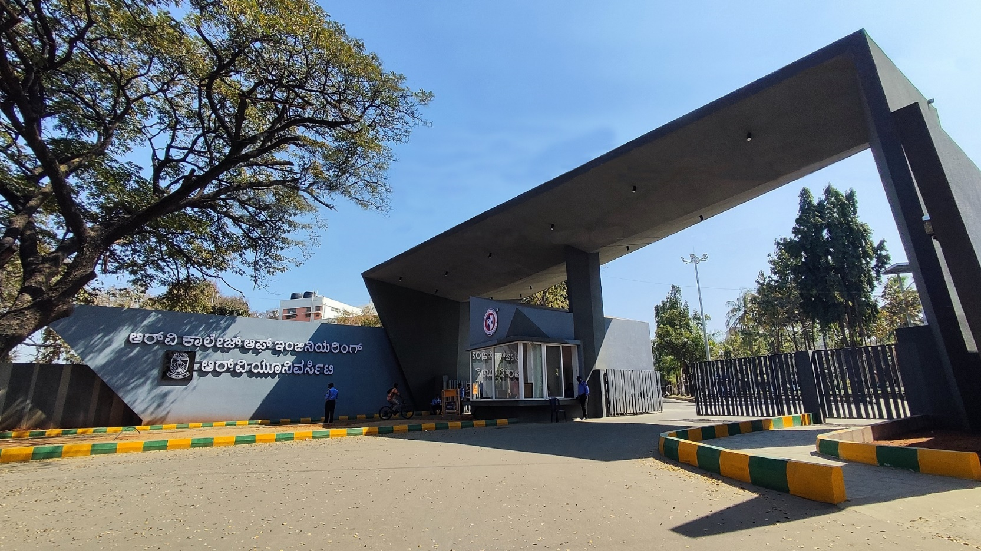
Indexing Lecture Videos for Smart Summarization
Theme & Project Number

Slide 2
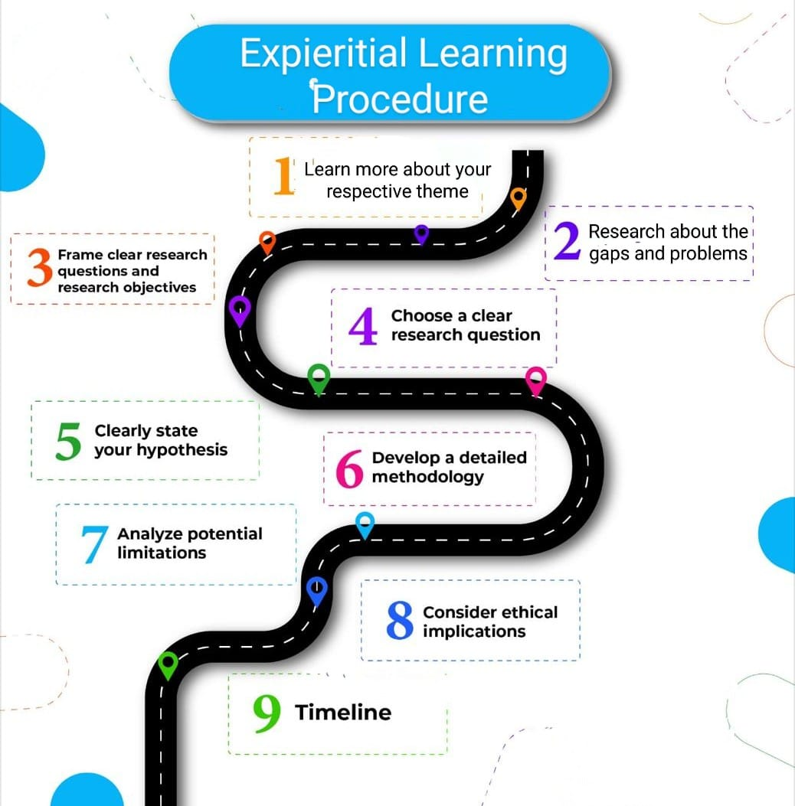

Slide 3
GROUP MEMBERS

Slide 4
EL Phase-I
Presentation Outline
Introduction
Literature Review
Problem Definition
Objectives
Methodology
Proposed Outcomes
Conclusion
References

Slide 5
Introduction
The increasing use of video lectures in educational platforms has created the need for automated systems that can summarize and extract key visual content from videos. Manual extraction of slides is inefficient and impractical for large volumes of content. Traditional video summarization techniques based on low-level visual features often struggle to handle gradual transitions, speaker overlays, or animations within lecture videos. To address these challenges, this project focuses on developing an AI–ML-based approach that accurately detects slide transitions and extracts clear slide snapshots along with their textual content for downstream applications such as search, summarization, and note generation.

Slide 6
Literature Review
Key studies and Findings: Recent studies show that slide transitions can be accurately detected using visual similarity and ML methods.
Deep models like TransNetV2 and SliTraNet achieve high accuracy in lecture videos.
These works prove automated slide extraction is reliable and practical.
Trends in Literature: Research is shifting from hand-crafted features to deep learning–based temporal models.
There is a growing focus on educational video indexing, summarization, and semantic search.
Multimodal models (vision + text) are emerging as the future direction.

Slide 7
Literature Review
Theoretical Framework: The framework relies on detecting visual changes between frames to identify slide boundaries.
Supervised ML models classify transitions, and OCR extracts text from detected slides.
Extracted text is indexed to enable search and summarization.
Relevance to current research: These studies validate the problem your project solves—automating slide extraction and indexing.
Your pipeline aligns with proven methods and can later integrate advanced models like TransNetV2.
The literature supports your system’s goal of making lecture videos searchable and easy to navigate.

Slide 8
Problem Definition
Traditional lecture videos often contain long, unstructured content that makes it difficult for students and educators to locate specific concepts, review important ideas, or navigate between sections efficiently. Although lecture slides and spoken explanations are delivered simultaneously, they are rarely aligned in post-lecture recordings. As a result, learners must manually search through the entire video to find relevant parts, leading to wasted time, reduced engagement, and inefficient revision.
Moreover, existing video platforms lack intelligent mechanisms to automatically extract key visuals, synchronize them with slide content, or index the concepts being discussed. Without a searchable and well-organized structure, lecture videos fail to serve as effective study resources.
AI-Powered Slide Sync addresses this gap by providing an automated system that analyzes lecture videos, extracts both slide frames and spoken audio, aligns them in real time with the corresponding slide content, and generates a searchable index of key topics. This solves the problem of poor navigability, lack of structure, and inefficient information retrieval from lecture videos.

Slide 9
Objectives
To design and implement an AI–ML pipeline for detecting slide transitions in lecture videos
To automatically capture and store high-quality screenshots of detected slides.
To perform OCR on extracted slides to retrieve textual information.
To provide metadata such as timestamps, slide indices, and text summaries for each slide.
To enable extensibility for future deep-learning and prompt-based retrieval techniques.

Slide 10
Methodology
The proposed system follows a multi-stage pipeline consisting of preprocessing, feature extraction, machine learning-based transition detection, OCR processing, and metadata generation. Initially, frames are extracted from the input video using OpenCV and compared sequentially to detect significant visual differences indicating a slide transition. Histogram difference, Structural Similarity Index (SSIM), and edge comparison metrics are used as features for transition detection. A supervised learning model such as Support Vector Machine (SVM) or Random Forest is trained on these features to classify frame pairs as transitions or non-transitions. Detected slide frames are cropped, cleaned, and processed using OCR (Tesseract or PaddleOCR) to extract textual content. The system then outputs the slides with associated timestamps and text summaries

Slide 11
Proposed Outcomes
Expected Results: The system will accurately detect slide transitions and extract slide frames automatically from lecture videos.
Each slide will be indexed with timestamps, and OCR will convert slide content into searchable text.
Users will be able to quickly navigate videos, search for topics, and access auto-generated summaries.
Potential Impact on the Field: The system will accurately detect slide transitions and extract slide frames automatically from lecture videos.
Each slide will be indexed with timestamps, and OCR will convert slide content into searchable text.
Users will be able to quickly navigate videos, search for topics, and access auto-generated summaries.

Slide 12
Proposed Outcomes
Future Research Directions:
Integration of advanced models such as TransNetV2, SliTraNet, or CLIP for semantic slide retrieval and multimodal understanding.
Integration of advanced models such as TransNetV2, SliTraNet, or CLIP for semantic slide retrieval and multimodal understanding.
Development of personalized learning analytics based on student search patterns and slide interaction.

Slide 13
Conclusion
The proposed AI-Powered SlideSync system aims to transform lengthy lecture videos into structured, searchable, and easy-to-navigate learning resources. By combining automated slide transition detection, OCR-based text extraction, and intelligent indexing, the project addresses a major challenge faced by students and educators—efficient access to relevant content within large video archives. The system not only improves the learning experience but also lays a foundational framework for advanced educational technologies such as semantic search, AI-driven summarization, and personalized learning analytics. Overall, this work contributes toward making digital learning more accessible, organized, and impactful.

Slide 14
References
A. Sindel et al., “SliTraNet: Automatic Detection of Slide Transitions in Lecture Videos using CNNs,” OAGM Workshop, 2022.
T. Souček and J. Lokoč, “TransNet V2: An Effective Deep Network Architecture for Fast Shot Transition Detection,” arXiv:2008.04838, 2020.
H. J. Jeong et al., “Automatic Detection of Slide Transitions in Lecture Videos,” Multimedia Tools and Applications, vol. 74, no. 18, 2015.
A. Radford et al., “Learning Transferable Visual Models From Natural Language Supervision,” arXiv:2103.00020, 2021.
H. Liu et al., 2023 – “Video Summarization Leveraging Multimodal Information for Presentations” (Interspeech)
PDF: https://www.isca-archive.org/interspeech_2023/liu23x_interspeech.pdf

Slide 15
References
Holmberg et al., 2025 – “Generating Narrated Lecture Videos from Slides with AI”
arXiv preprint: https://arxiv.org/abs/2505.02966
“Summarization of Multimodal Presentations with Vision–Language Models” (2025)
arXiv preprint: https://arxiv.org/abs/2504.10049
H. Liu et al., 2023 – “Video Summarization Leveraging Multimodal Information for Presentations” (Interspeech)
PDF: https://www.isca-archive.org/interspeech_2023/liu23x_interspeech.pdf
“Educational Video Summarisation” (IJFMR, 2024) – uses transcripts + LLM-based summarization for educational videos.
PDF: https://www.ijfmr.com/papers/2024/6/32711.pdf
“Automated Summarization of Lecture Videos”
ResearchGate entry (PDF): https://www.researchgate.net/publication/329952893_Automated_Summarization_of_Lecture_Videos

Slide 16
References
“Video Lecture Summarization Using Machine Learning” (IJIRT)
PDF: https://ijirt.org/publishedpaper/IJIRT151416_PAPER.pdf
“Educational Videos Subtitles’ Summarization Using Latent Dirichlet Allocation (LDA)”
TechScience CMC: https://www.techscience.com/cmc/v70n3/45033/html
Xiangyu et al., 2009 – “A Robust Framework for Aligning Lecture Slides with Video” (ICIP)
PDF: https://www.comp.nus.edu.sg/~mohan/papers/icip2009.pdf
Xiangyu et al., 2009 – “A Robust Framework for Aligning Lecture Slides with Video” (ICIP)
PDF: https://www.comp.nus.edu.sg/~mohan/papers/icip2009.pdf
Xiangyu et al., 2009 – “A Robust Framework for Aligning Lecture Slides with Video” (ICIP)
PDF: https://www.comp.nus.edu.sg/~mohan/papers/icip2009.pdf

Slide 17
Expected Outcome by the end of First Year
Patent Filing: If the system demonstrates novel functionality in slide detection or video summarization, a patent can be filed. This includes preparing the patent description, claims, and conducting a prior art search.
Journal Publication: The complete methodology, experimental results, and system evaluation can be written as a full research paper. It can be submitted to Scopus-indexed journals in AI, educational technology, or multimedia processing.
Conference Publication: The complete methodology, experimental results, and system evaluation can be written as a full research paper. It can be submitted to Scopus-indexed journals in AI, educational technology, or multimedia processing.
Research Proposal:The complete methodology, experimental results, and system evaluation can be written as a full research paper. It can be submitted to Scopus-indexed journals in AI, educational technology, or multimedia processing.

Slide 18


